Slide 1
Extended ACLs

Slide 2
Extended ACLs
For more precise traffic-filtering control: extended IPv4 ACLs can be used.
Extended ACLs can be numbered; and can also be named (as with standard lists).
Extended ACLs have the ability:
  to check source addresses of packets (as with standard ACLs)
  Further, they can check the destination address, protocols, and port numbers (services)
Notes:
For more precise traffic-filtering control, extended IPv4 ACLs can be created. Extended ACLs are numbered 100 to 199 and 2000 to 2699, providing a total of 799 possible extended numbered ACLs. Extended ACLs can also be named.
Extended ACLs are used more often than standard ACLs because they provide a greater degree of control. Extended ACLs have the ability to check source addresses of packets, but they also have the ability to check the destination address, protocols, and port numbers (or services). This provides a greater range of criteria on which to base the ACL. For example, one extended ACL can allow email traffic from a network to a specific destination while denying file transfers and web browsing.

Slide 3


Filtering Ports and Services
The ability to filter on protocol and port number allows network administrators to build very specific extended ACLs.
An application can be specified by configuring either the port number or the name of a well-known port.
Logical operations can be used, such as equal (eq), not equal (neq), greater than (gt), and less than (lt).
Notes:
In the examples: an administrator specifies a TCP or UDP port number by placing it at the end of the extended ACL statement. Logical operations can be used, such as equal (eq), not equal (neq), greater than (gt), and less than (lt).
The other example shows how to display a list of port numbers and keywords that can be used when building an ACL using the command (as an example):
R1(config)# access-list 101 permit tcp any any eq ?

Slide 4
router(config)#access-list access-list-number {deny|permit|remark} protocol {source source-wildcard} { destination destination-wildcard } [operator port [port number or name]]
Numbered Extended ACLs: Syntax
Notes:
The procedural steps for configuring extended ACLs are the same as for standard ACLs. The extended ACL is first configured, and then it is activated on an interface. However, the command syntax and parameters are more complex to support the additional features provided by extended ACLs.
The order in which the statements are entered during configuration is the order they are displayed and processed.
Note that there are many keywords and parameters for extended ACLs. It is not necessary to use all of the keywords and parameters when configuring an extended ACL. Recall that the ? can be used to get help when entering complex commands.

Slide 5
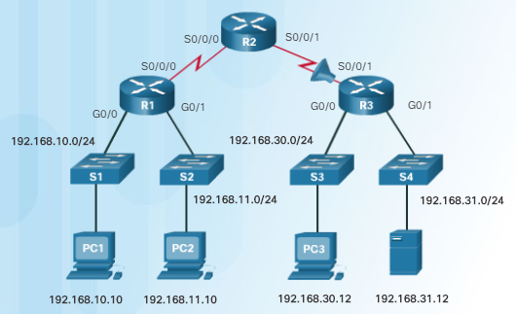

Example 1
The order of the ACEs is important: the most common errors are entering ACEs in the wrong order and not applying adequate criteria to the ACL rules.
In the figure and as a result of using an access list: host 192.168.10.10 has no Telnet connectivity with 192.168.30.12.
When viewing the output of the show access-lists command, matches are shown for the first deny statement: this is an indicator that this statement has been matched by traffic.

Slide 6
Example 1 (Cont)
Look at the order of the ACEs. Host 192.168.10.10 has no connectivity with 192.168.30.12 because of the order of rule 10 in the access list.
Because the router processes ACLs from the top down, statement 10 denies host 192.168.10.10, so statement 20 can never be matched.
Statements 10 and 20 should be reversed. The last line allows all other non-TCP traffic that falls under IP (ICMP, UDP, etc.).

Slide 7
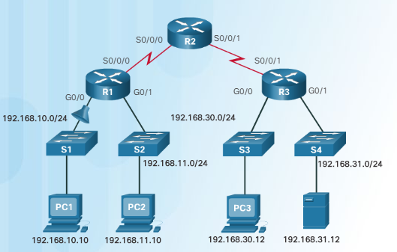

Example 2:
Be aware of possible consequences!
In the figure, the 192.168.10.0/24 network cannot use TFTP to connect to the 192.168.30.0/24 network.

Slide 8
Example 2 (Cont):
The 192.168.10.0/24 network cannot use TFTP to connect to the 192.168.30.0/24 network because TFTP uses the transport protocol UDP.
Statement 30 in access list 120 allows all other TCP traffic. However, because TFTP uses UDP instead of TCP, it is implicitly denied. Recall that the implied deny any statement does not appear in show access-lists output and therefore matches are not shown.
Statement 30 could / should be ip any any.
This ACL works whether it is applied to G0/0 of R1, or S0/0/1 of R3, or S0/0/0 of R2 in the incoming direction. However, based on the rule about placing extended ACLs closest to the source, the best option is to place it inbound on G0/0 of R1 because it allows undesirable traffic to be filtered without crossing the network infrastructure.
Notes:
The 192.168.10.0/24 network cannot use TFTP to connect to the 192.168.30.0/24 network because TFTP uses the transport protocol UDP. Statement 30 in access list 120 allows all other TCP traffic. However, because TFTP uses UDP instead of TCP, it is implicitly denied. Recall that the implied deny any statement does not appear in show access-lists output and therefore matches are not shown.
Statement 30 should be ip any any.
This ACL works whether it is applied to G0/0 of R1, or S0/0/1 of R3, or S0/0/0 of R2 in the incoming direction. However, based on the rule about placing extended ACLs closest to the source, the best option is to place it inbound on G0/0 of R1 because it allows undesirable traffic to be filtered without crossing the network infrastructure.

Slide 9
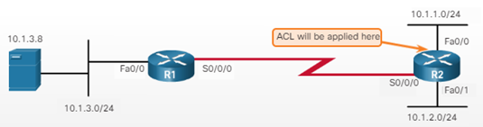
Create a numbered ACL that will only allow users on the 10.1.1.0/24 network to have HTTP access to the web server on the 10.1.3.0/24 network. The ACL is applied to R2 Fa0/0 inbound.
Sol: access-list 101 permit tcp 10.1.1.0 0.0.0.255 host 10.1.3.8 eq 80
Example 3:

Slide 10
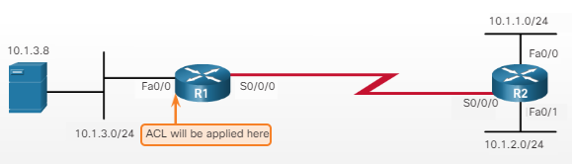
Example 4:
Create a numbered ACL that will allow only host 10.1.3.8 on the 10.1.3.0/24 network to reach destinations beyond that network. The ACL is applied to the R1 Fa0/0 inbound.
Sol: access-list 150 permit ip host 10.1.3.8 any

Slide 11
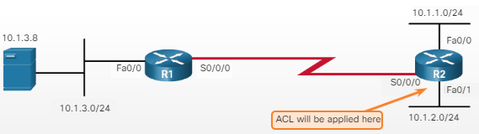
Example 5:
What does the following extended ACL do:
access-list 122 deny tcp host 10.1.2.9 10.1.1.0 0.0.0.255 eq 21
Sol: Such ACL blocks host 10.1.2.9 from having FTP (since FTP uses port 21) access to the 10.1.1.0/24 network.
Notes:
What does the following extended ACL do: access-list 122 deny tcp host 10.1.2.9 10.1.1.0 0.0.0.255 eq 21
Sol: Such ACL blocks host 10.1.2.9 from having FTP (since FTP uses port 21) access to the 10.1.1.0/24 network.

